Slide 1

X-ray mirror system design and specification
Xianbo Shi
Optics Group, Advanced Photon Source

Slide 2
OUTLINE
General introduction to X-ray mirror optics and focusing geometry
Mirror specifications
Mechanical motion, misalignment, and stability
Optics aberration
APS-U bender mirrors
Design concepts
Additional specs: twist and gravity sag
Beamline mirror operation
Adaptive mirrors
In-situ metrology and wavefront sensing
Advanced control
2

Slide 3
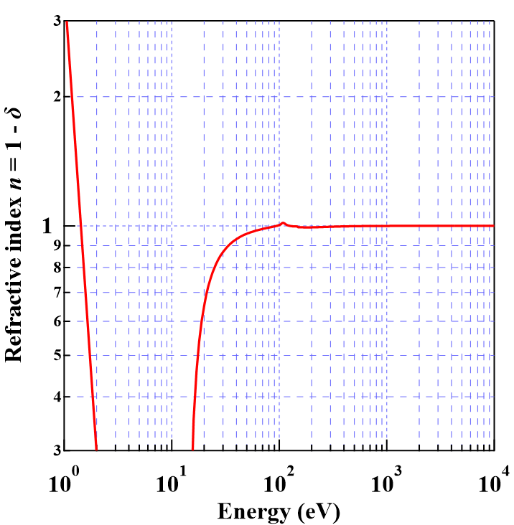
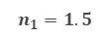
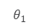
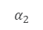
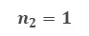
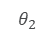
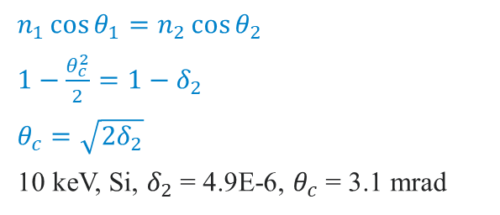
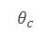
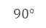
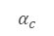
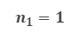
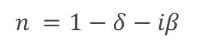
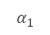
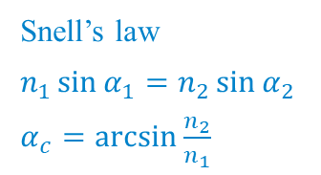
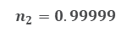
introduction to X-ray mirrors
Total (internal) reflection
Refractive index of silicon
$$n =1−δ−iβ$$
$$α_{2}$$
Snell’s law
$n_{1}\sin{α_{1}}=n_{2}\sin{α_{2}}$
$α_{c}=\arcsin{\frac{n_{2}}{n_{1}}}$
$$90°$$
$$n_{2}=1$$
$$n_{1}=1.5$$
$$α_{1}$$
$$α_{c}$$
Total reflection
Visible light
X-ray
$n_{1}\cos{θ_{1}}=n_{2}\cos{θ_{2}}$
$1−\frac{θ_{c}^{2}}{2}=1−δ_{2}$
$θ_{c}=\sqrt{2δ_{2}}$
10 keV, Si, $δ_{2}$ = 4.9E-6, $θ_{c}$ = 3.1 mrad
$$θ_{c}$$
$$θ_{2}$$
$$n_{2}=0.99999$$
$$θ_{1}$$
$$n_{1}=1$$
Total reflection

Slide 4
X-ray mirror shapes
1D focusing/collimating
Source
Diverging beam
Focus
Focus
Elliptical mirror
real source → real focus
Mirror
Mirror
Parabolic mirror
parallel beam → real focus
Hyperbolic mirror
virtual source
→ real focus
Focus
Source
Virtual source
Mirror
Converging beam
Parabolic mirror
real source → parallel beam
Mirror
4

Slide 5
X-ray mirror shapes
2D focusing
Ellipsoidal mirror
Toroidal mirror only approximates to an ellipsoid near the center of the mirror.
Kirkpatrick-Baez (KB) configuration
Each mirror is a elliptical cylinder
5

Slide 6
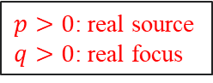

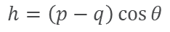
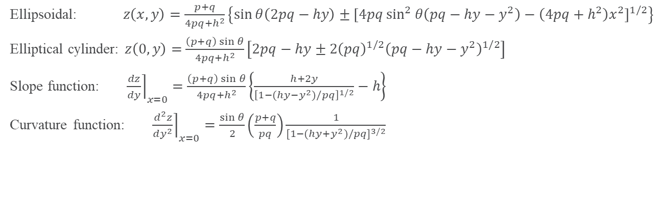


X-ray mirror shapes
Surface shape in mirror coordinate
$p>0$: real source
$q>0$: real focus
Source
$$p$$
z
$$q$$
Focus
$$θ$$
y
Exact solution
Elliptical cylinder mirror
x
$${\left[x^{2}+{\left(p\cos{θ}+y\right)}^{2}+{\left(p\sin{θ}−z\right)}^{2}\right]}^{1/2}+{\left[x^{2}+{\left(q\cos{θ}−y\right)}^{2}+{\left(p\sin{θ}−z\right)}^{2}\right]}^{1/2}=p+q$$
$$h=\left(p−q\right)\cos{θ}$$
Ellipsoidal: $z\left(x,y\right)=\frac{p+q}{4pq+h^{2}}\left\{\sin{θ\left(2pq−hy\right)±{\left[4pq\sin^{2}{θ\left(pq−hy−y^{2}\right)−\left(4pq+h^{2}\right)x^{2}}\right]}^{1/2}}\right\}$
Elliptical cylinder: $z\left(0,y\right)=$ $\frac{\left(p+q\right)\sin{θ}}{4pq+h^{2}}\left[2pq−hy±2{\left(pq\right)}^{1/2}{\left(pq−hy−y^{2}\right)}^{1/2}\right]$
Slope function: ${\left.\frac{dz}{dy}\right\rceil }_{x=0}=\frac{\left(p+q\right)\sin{θ}}{4pq+h^{2}}\left\{\frac{h+2y}{{\left[1−(hy−y^{2})/pq\right]}^{1/2}}−h\right\}$
Curvature function: ${\left.\frac{d^{2}z}{dy^{2}}\right\rceil }_{x=0}=\frac{\sin{θ}}{2}\left(\frac{p+q}{pq}\right)\frac{1}{{[1−(hy+y^{2})/pq]}^{3/2}}$
K. A. Goldberg, J. Synchrotron Rad. 29, 991 (2022). doi:10.1107/S1600577522005793
6

Slide 7
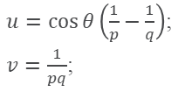
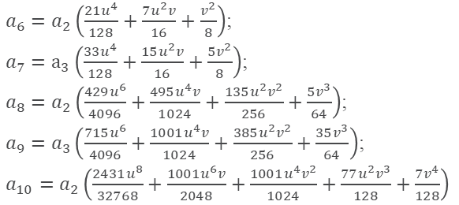
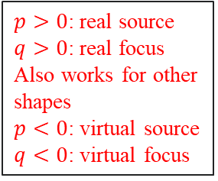
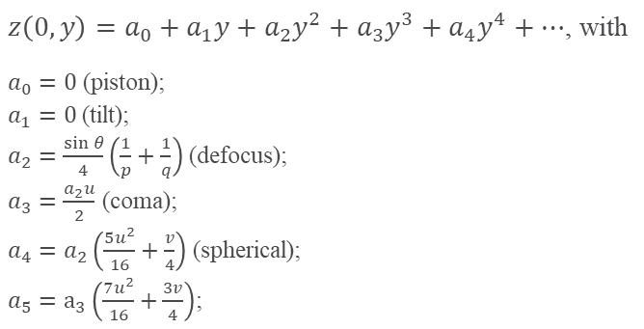
X-ray mirror shapes
Surface shape in mirror coordinate
$p>0$: real source
$q>0$: real focus
Also works for other shapes
$p<0$: virtual source
$q<0$: virtual focus
Source
$$p$$
z
$$q$$
Focus
$$θ$$
y
Taylor expansion
Elliptical cylinder mirror
x
$z\left(0,y\right)=a_{0}+a_{1}y+a_{2}y^{2}+a_{3}y^{3}+a_{4}y^{4}+⋯$, with
$a_{0}=0$ (piston);
$a_{1}=0$ (tilt);
$a_{2}=\frac{\sin{θ}}{4}\left(\frac{1}{p}+\frac{1}{q}\right)$ (defocus);
$a_{3}=\frac{a_{2}u}{2}$ (coma);
$a_{4}=a_{2}\left(\frac{5u^{2}}{16}+\frac{v}{4}\right)$ (spherical);
$a_{5}=a_{3}\left(\frac{7u^{2}}{16}+\frac{3v}{4}\right)$;
$a_{6}=a_{2}\left(\frac{21u^{4}}{128}+\frac{7u^{2}v}{16}+\frac{v^{2}}{8}\right)$;
$a_{7}=a_{3}\left(\frac{33u^{4}}{128}+\frac{15u^{2}v}{16}+\frac{5v^{2}}{8}\right)$;
$a_{8}=a_{2}\left(\frac{429u^{6}}{4096}+\frac{495u^{4}v}{1024}+\frac{135u^{2}v^{2}}{256}+\frac{5v^{3}}{64}\right)$;
$a_{9}=a_{3}\left(\frac{715u^{6}}{4096}+\frac{1001u^{4}v}{1024}+\frac{385u^{2}v^{2}}{256}+\frac{35v^{3}}{64}\right)$;
$a_{10}=a_{2}\left(\frac{2431u^{8}}{32768}+\frac{1001u^{6}v}{2048}+\frac{1001u^{4}v^{2}}{1024}+\frac{77u^{2}v^{3}}{128}+\frac{7v^{4}}{128}\right)$
$u=\cos{θ}\left(\frac{1}{p}−\frac{1}{q}\right)$;
$v=\frac{1}{pq}$;
One-moment
Two-moment
Gravity sag
M. Howells, et al., Opt. Eng. 39, 2748 (2000). doi:10.1117/1.1289879
7

Slide 8
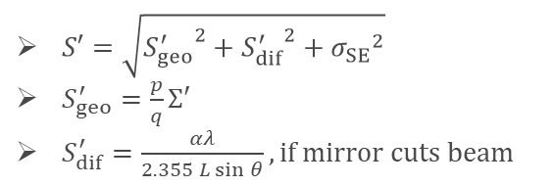
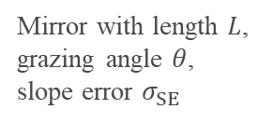
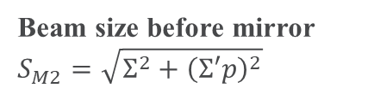
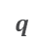
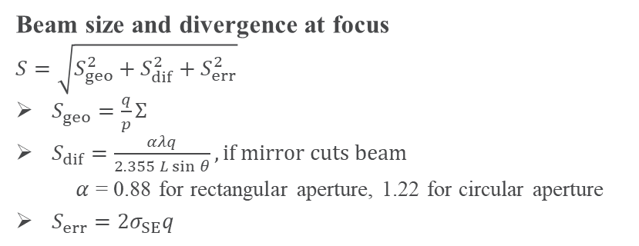

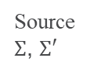
Focusing geometry
Direct focusing: analytical calculation
$$p$$
$$q$$
Focus
Source
$Σ$, $Σ′$
Mirror with length $L$, grazing angle $θ$, slope error $σ_{SE}$
Beam size before mirror
$$S_{M2}=\sqrt{Σ^{2}+{\left(Σ′p\right)}^{2}}$$
Note: slope error is not a good criteria for specifying diffraction limited mirrors
Beam size and divergence at focus
$$S=\sqrt{S_{geo}^{2}+S_{dif}^{2}+S_{err}^{2}}$$
$S_{geo}=\frac{q}{p}Σ$
$S_{dif}=\frac{αλq}{2.355 L\sin{θ}}, if mirror cuts beam$
$α$ = 0.88 for rectangular aperture, 1.22 for circular aperture
$S_{err}=2σ_{SE}q$
$S′=\sqrt{{S_{geo}^{′}}^{2}+{S_{dif}^{′}}^{2}+{σ_{SE}}^{2}}$
$S_{geo}^{′}=\frac{p}{q}Σ′$
$S_{dif}^{′}=\frac{αλ}{2.355 L\sin{θ}}, if mirror cuts beam$
X. Shi, et al., Proc. SPIE 10388, 103880C (2017). doi:10.1117/12.2274571
8

Slide 9
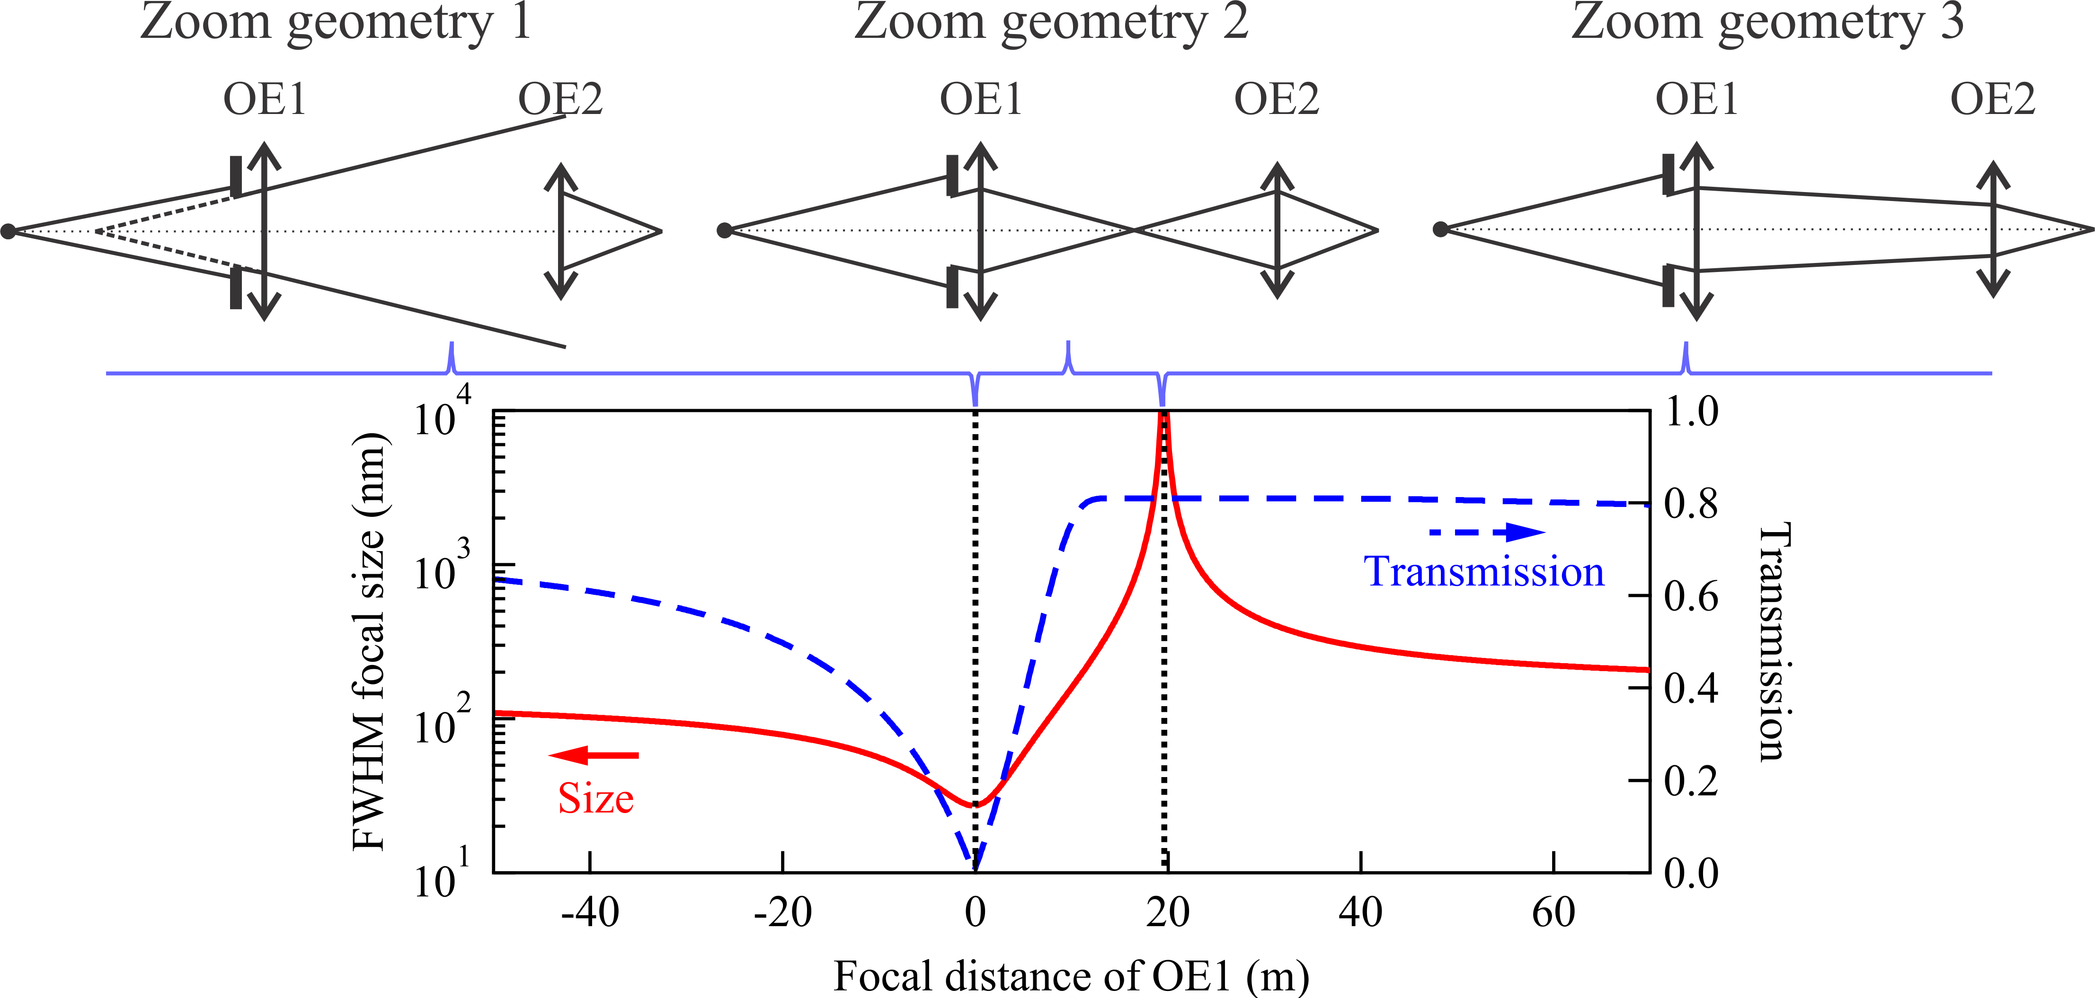
Focusing geometry
Zoom focus
X. Shi, et al., Proc. SPIE 10388, 103880C (2017). doi:10.1117/12.2274571
9

Slide 10
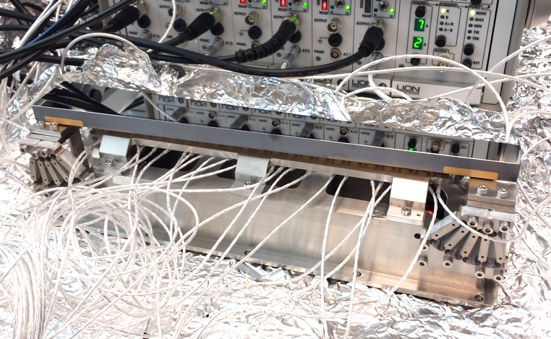
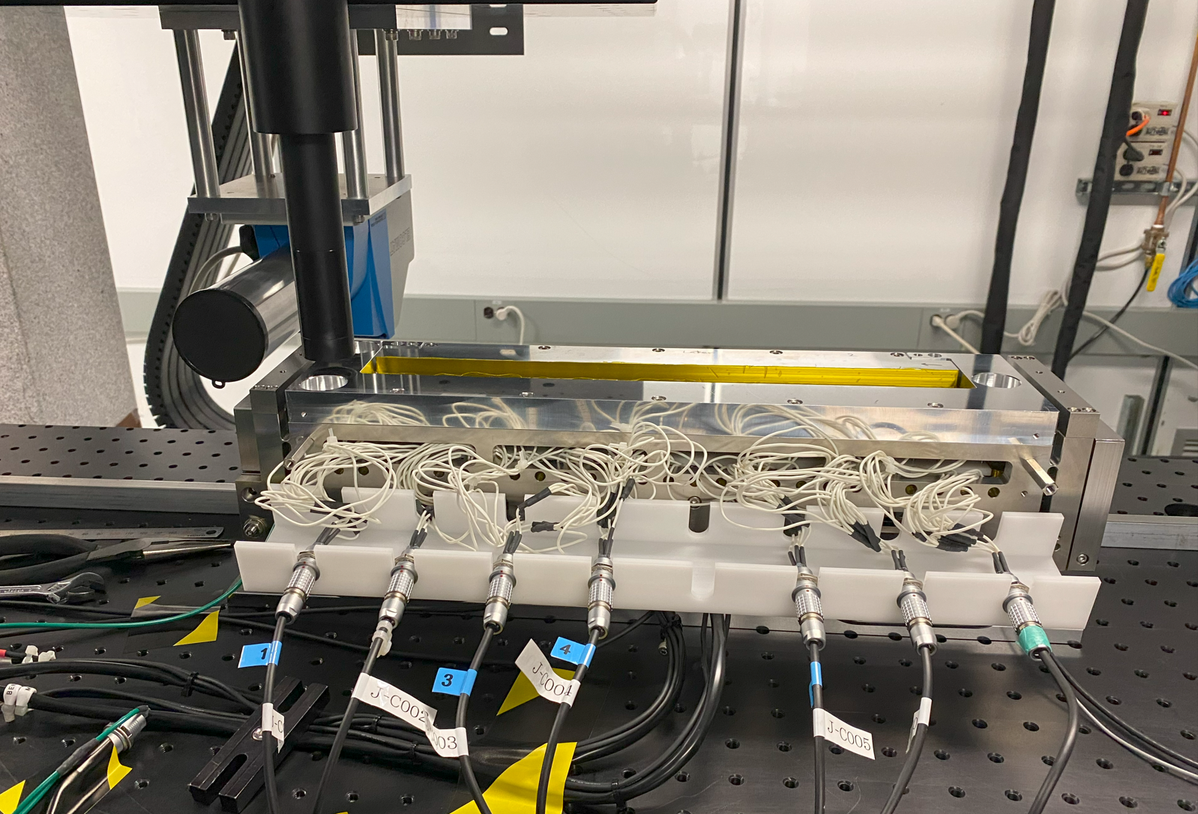
Focusing geometry
Zoom focus
KB mirror 2
KB mirror 1
Source
WF sensor
Bender mirror
Hybrid mirror (bender+bimorph)
KB Mirror
Transfocator
Source
WF sensor
10

Slide 11
Mirror specifications
Mechanical motion, misalignment, and stability
Optics aberration

Slide 12
Mirror specifications
APS-U optics ESD example:
Specification of mirror positioners and motors
Specification of mirror stability
Specification of mirror substrate
12

Slide 13
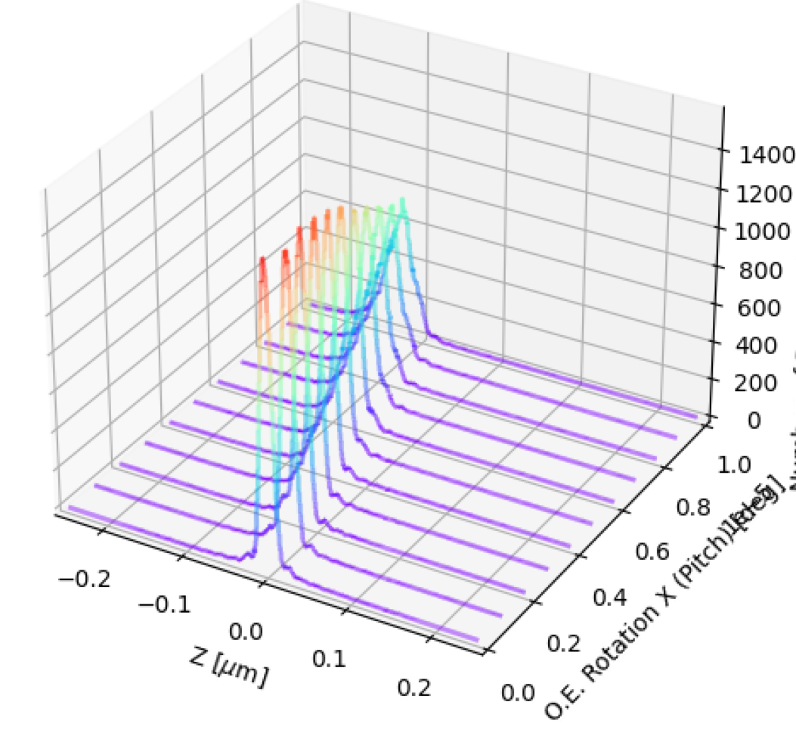
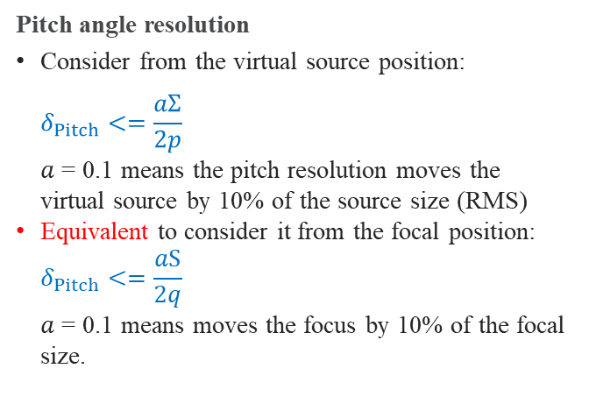
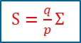

Mirror specifications
Z
Yaw
Mechanical motion and misalignment
Beam
Source
Y
$$p$$
$$δ$$
$$2δ$$
Focus
$S=\frac{q}{p}Σ$
Roll
$$2δ$$
Pitch
X
Source dimension: $Σ$, $Σ′$, $Σ_{⊥}$, $Σ_{⊥}^{′}$
$$q$$
Pitch angle resolution
Consider from the virtual source position:
$$δ_{Pitch}<=\frac{aΣ}{2p}$$
$a$ = 0.1 means the pitch resolution moves the virtual source by 10% of the source size (RMS)
Equivalent to consider it from the focal position:
$$δ_{Pitch}<=\frac{aS}{2q}$$
$a$ = 0.1 means moves the focus by 10% of the focal size.
From focal size broadening (less sensitive):
pitch angle change < the angle to increase the virtual source size by 10%
13

Slide 14
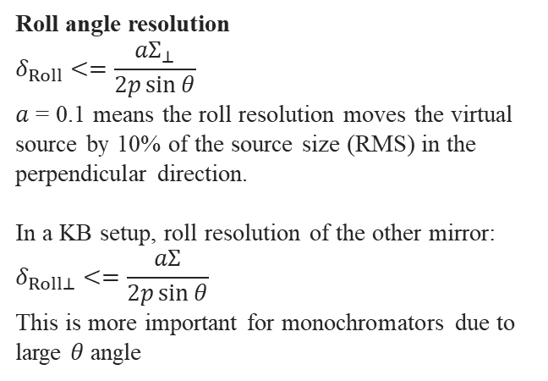
Mirror specifications
Z
Yaw
Mechanical motion and misalignment
Beam
Source
Y
$$p$$
$$δ$$
$$2δ$$
Focus
$S=\frac{q}{p}Σ$
Roll
$$2δ$$
Pitch
X
Source dimension: $Σ$, $Σ′$, $Σ_{⊥}$, $Σ_{⊥}^{′}$
$$q$$
Roll angle resolution
$$δ_{Roll}<=\frac{aΣ_{⊥}}{2p\sin{θ}}$$
$a$ = 0.1 means the roll resolution moves the virtual source by 10% of the source size (RMS) in the perpendicular direction.
In a KB setup, roll resolution of the other mirror:
$$δ_{Roll⊥}<=\frac{aΣ}{2p\sin{θ}}$$
This is more important for monochromators due to large $θ$ angle
Yaw angle resolution
Dominated by beam tilting over the coating stripe width, normally in the 0.01° level.
Beam size broadening vs yaw (less sensitive)
14

Slide 15
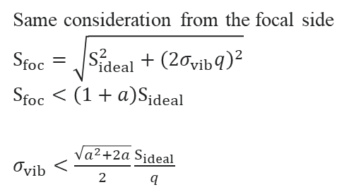
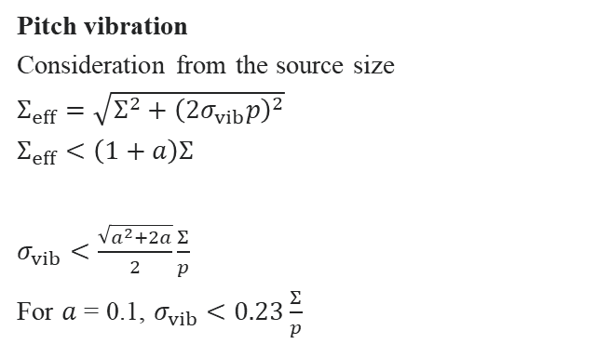

Mirror specifications
Z
Yaw
Stability
Beam
Source
Y
$$p$$
$$δ$$
$$2δ$$
Focus
$S_{ideal}=\frac{q}{p}Σ$
Roll
$$2δ$$
Pitch
X
Source dimension: $Σ$, $Σ′$, $Σ_{⊥}$, $Σ_{⊥}^{′}$
$$q$$
Pitch vibration
Consideration from the source size
$Σ_{eff}=\sqrt{Σ^{2}+{\left({2σ}_{vib}p\right)}^{2}}$
$Σ_{eff}<\left(1+a\right)Σ$
$σ_{vib}<\frac{\sqrt{a^{2}+2a}}{2}\frac{Σ}{p}$
For $a$ = 0.1, $σ_{vib}<0.23\frac{Σ}{p}$
Same consideration from the focal side
$$S_{foc}=\sqrt{S_{ideal}^{2}+{\left(2σ_{vib}q\right)}^{2}}$$
$S_{foc}<\left(1+a\right)S_{ideal}$
$σ_{vib}<\frac{\sqrt{a^{2}+2a}}{2}\frac{S_{ideal}}{q}$
15

Slide 16
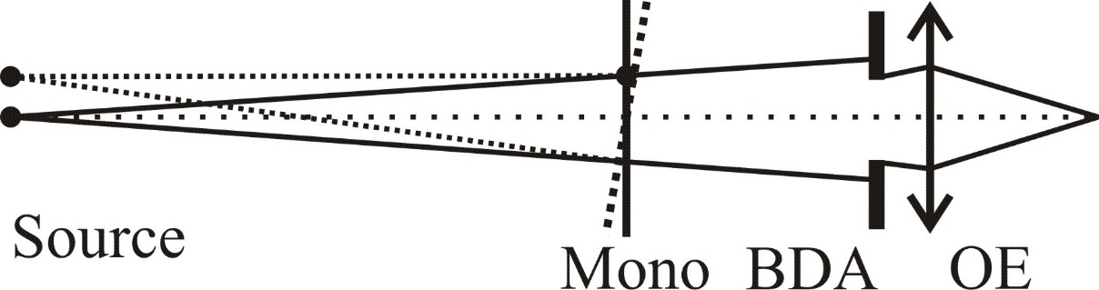
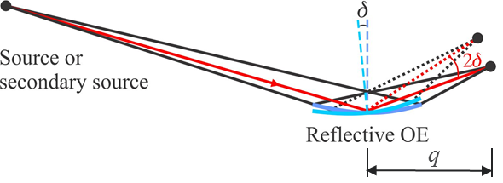
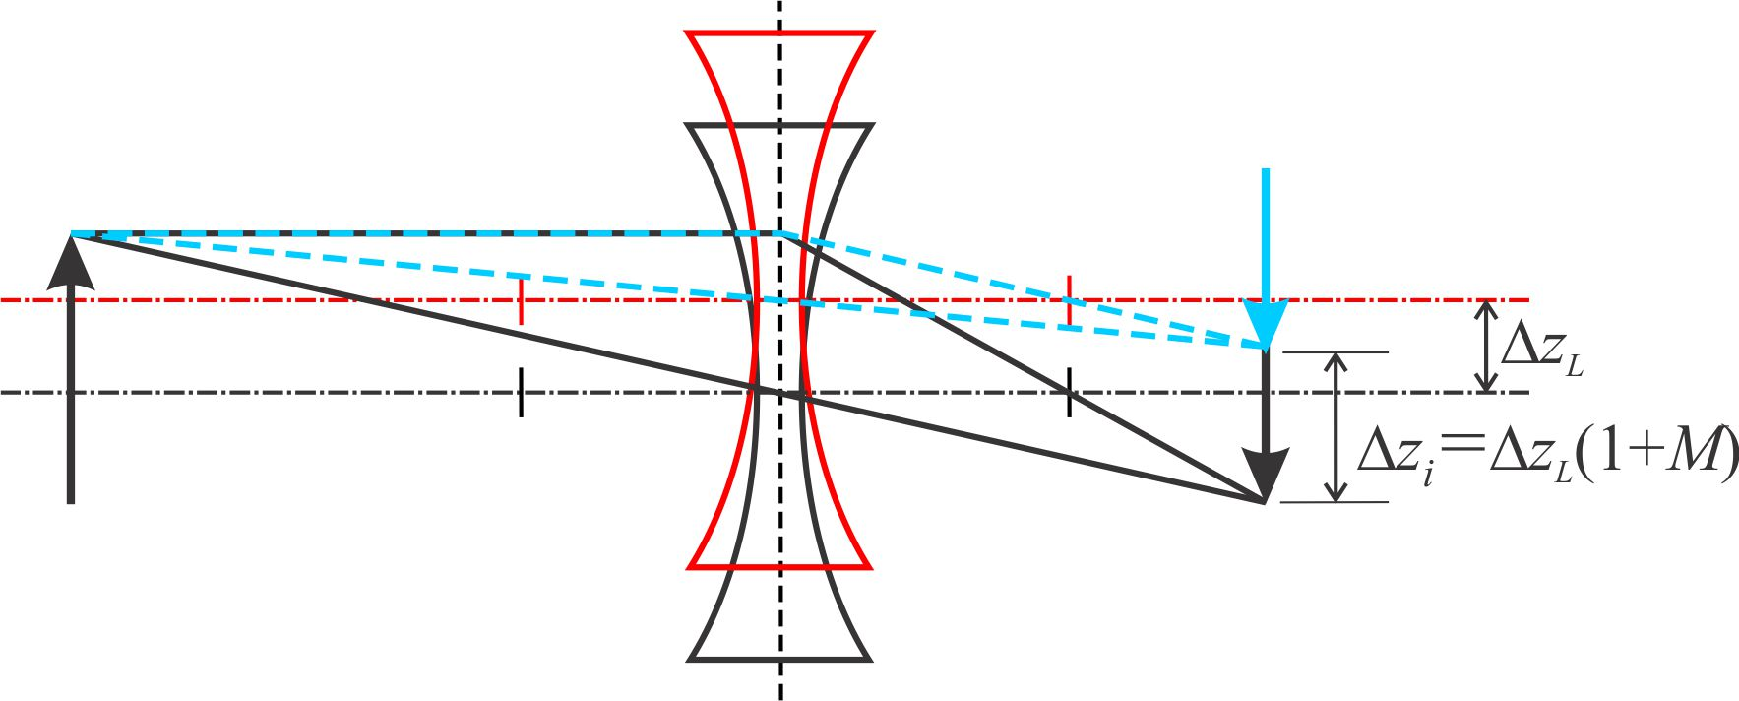
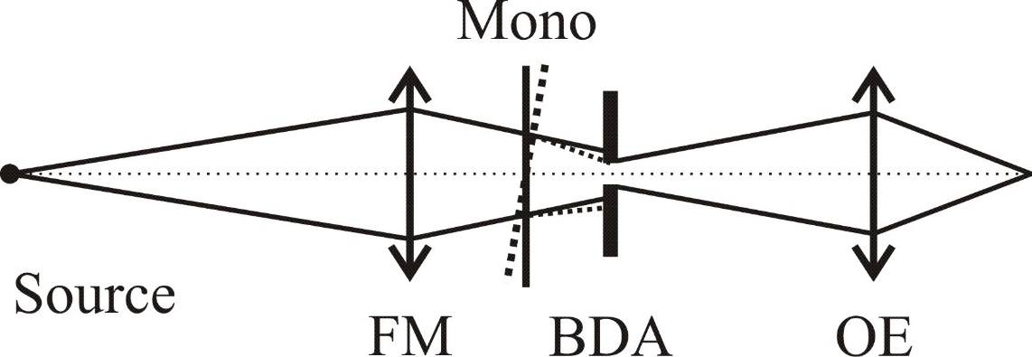

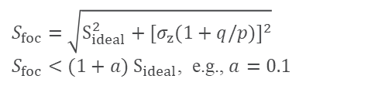
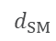
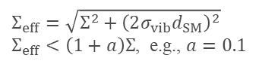
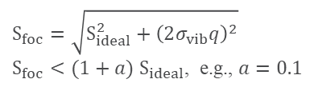
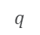
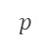
Optics stability specifications
Monochromator relative pitch vibration
Focusing mirror angular vibration
$$Σ_{eff}=\sqrt{Σ^{2}+{\left(2σ_{vib}d_{SM}\right)}^{2}}$$
$Σ_{eff}<\left(1+a\right)Σ$, e.g., $a=0.1$
$$d_{SM}$$
$$S_{foc}=\sqrt{S_{ideal}^{2}+{\left(2σ_{vib}q\right)}^{2}}$$
$S_{foc}<(1+a) S_{ideal}$, e.g., $a=0.1$
Focusing lens positional vibration
$$1/\sqrt{N_{optics}}$$
$$p$$
$$q$$
X. Shi, et al., Proc. SPIE 10388, 103880C (2017 ). doi:10.1117/12.2274571
$$S_{foc}=\sqrt{S_{ideal}^{2}+{[σ_{z}(1+q/p)]}^{2}}$$
$$S_{foc}<(1+a) S_{ideal}\text{, }\text{e}\text{.}\text{g}\text{., }a=0.1$$
BDA serves as the new source and isolates the source and Mono vibration.
16

Slide 17
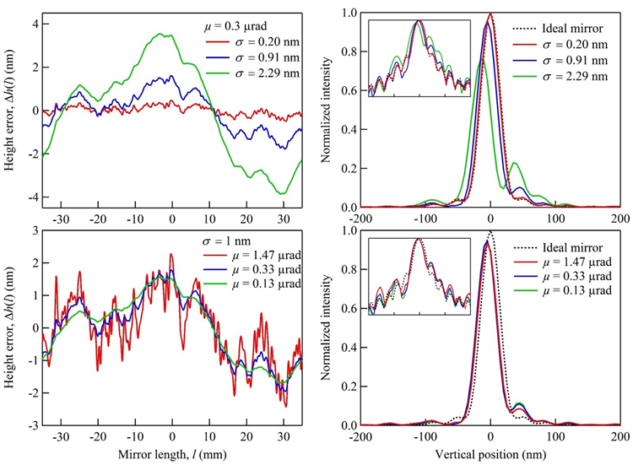
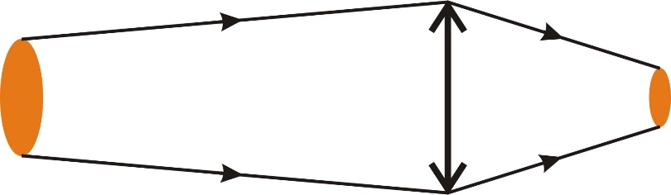
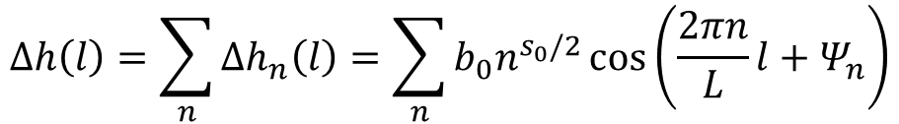
Mirror surface aberration
Slope error? or Height error?
Diffraction limited focusing, 1000:1, 70 mm long mirror
s₀ – slope of log(PSD) vs log(f)
For diffraction limited focusing mirrors, the height error is a better measure of the surface quality.
X. Shi, et al., Proc. SPIE 9687, 968703 (2016). doi:10.1117/12.2241139
17

Slide 18


Mirror surface aberration
Slope error? or Height error?
Non-diffraction limited focusing, 100:1, 400 mm long mirror
The on-axis Strehl ratio
$$\frac{I\left(0\right)}{I_{0}\left(0\right)}=1−\frac{8}{Θ^{2}}σ_{SE}^{2}−{\left(\frac{4π}{λ}\sin{θ}\right)}^{2}σ_{HE}^{2}$$
with the low frequency slope error:
$σ_{SE}^{2}={\left(2π\right)}^{2}\int_{1/L}^{1/W}{PSD\left(f\right)f^{2}df}$
and the high frequency roughness:
$σ_{HE}^{2}={\left(2π\right)}^{2}\int_{1/W}^{1/λ}{PSD\left(f\right)df}$
$W=\frac{\sqrt{2}λ}{Θ\sin{θ}}$, $Θ$ is the angular size of the image
Church, E. L., & Takacs, P. Z. Opt. Eng., 34, 353 (1995). doi: 10.1117/12.196057
Mirror at 50 m, θ = 3 mrad, E = 10 keV
 | Source (μm) | W (mm)
APS, H | 640 | 4.5
APS-U, H | 36 | 80
APS-U, V | 15 | 200
X. Shi, et al., Proc. SPIE 9687, 968703 (2016). doi:10.1117/12.2241139
18

Slide 19





Mirror surface aberration
Simulation
DABAM - an open-source database of x-ray mirrors metrology.
M. Sanchez, et al., J. Synchrotron Rad. 23, 665 (2016).
Mirror figure error specification:
The RMS (PV) height error of the mirror to keep both the focal size broadening and the peak intensity reduction by less than 10%.
19
L. Rebuffi and X. Shi, Proc. SPIE 11493, 1149303 (2020). doi:10.1117/12.2567501

Slide 20
APS-U bender mirrors
Design concepts
Additional specs: twist and gravity sag

Slide 21





Design concept
Two-moment bender equation (general)
$$EI_{0}\frac{d^{2}z}{dy^{2}}=\frac{M_{1}+M_{2}}{2}−\frac{M_{1}−M_{2}}{L}y$$
where $E$ is Young’s modulus of elasticity, $L$ is the mirror length, $I_{0}$ is the moment of inertia of the beam cross-section, given by
$$I_{0}=\frac{W(y)h^{3}}{12}$$
Substituting the exact elliptical equation (radius of curvature):
$${\left.\frac{1}{R_{ideal}\left(y\right)}=\frac{d^{2}z}{dy^{2}}\right\rceil }_{x=0}=\frac{\sqrt{pq}\left(p+q\right)\sin{θ}}{{2\left[pq−y\left(p−q\right)\cos{θ}−y^{2}\right]}^{3/2}}$$
The variable width is given by
$$W\left(y\right)=\left(\frac{M_{1}+M_{2}}{2}−\frac{M_{1}−M_{2}}{L}y\right)\frac{{24\left[pq−y\left(p−q\right)\cos{θ}−y^{2}\right]}^{3/2}}{Eh^{3}\sqrt{pq}\left(p+q\right)\sin{θ}}$$
$y$ = 0 at the mirror center
$p$ = 60 m
$q$ = 500 mm
$θ$ = 3 mrad
$E$ = 1.31e5 N/mm²
$L$ = 250 mm
$h$ = 10 mm
FEA analysis
$$W_{n+1}(y)=\frac{W_{n}\left(y\right)R_{ideal}(y)}{R_{n}(y)}$$
L. Zhang, et al., AIP Conference Proceedings 1234, 801 (2010). doi:10.1063/1.3463335
21

Slide 22





Design concept
Two-moment bender equation with trapezoidal/rectangular mirror
$$EI_{0}\frac{d^{2}z}{dy^{2}}=\frac{M_{1}+M_{2}}{2}−\frac{M_{1}−M_{2}}{L}y$$
where $E$ is Young’s modulus of elasticity, $L$ is the mirror length, $I_{0}$ is the moment of inertia of the beam cross-section, given by
$I_{0}=\frac{W(y)h^{3}}{12}$, with $W(y)=W_{0}+\frac{y+L/2}{L}eW_{0}$
$$z=H\left[\left(\frac{C+Dy}{D}\right)\ln\left(C+Dy\right)−y\right]−\frac{By^{2}}{2D}+Fy+G$$
$$A=\frac{M_{1}+M_{2}}{2}, B=\frac{M_{1}−M_{2}}{L}, C=\frac{Eh^{3}}{24}\left(2W_{0}+eW_{0}\right), D=\frac{Eh^{3}eW_{0}}{12L},H=\frac{AD+BC}{D^{2}}$$
$$G=−\frac{H}{2}\left[\left(\frac{C−DL/2}{D}\right)\ln\left(C−\frac{DL}{2}\right)+\left(\frac{C+DL/2}{D}\right)\ln\left(C+\frac{DL}{2}\right)\right]+\frac{BL^{2}}{8D}$$
$$F=\frac{H}{L}\left[\left(\frac{C−DL/2}{D}\right)\ln\left(C−\frac{DL}{2}\right)−\left(\frac{C+\frac{DL}{2}}{D}\right)\ln\left(C+\frac{DL}{2}\right)+L\right]$$
Rectangular mirror: $e$ = 0
$$z=−\frac{By^{3}}{6C}+\frac{Ay^{2}}{2C}+Fy+G$$
$$A=\frac{M_{1}+M_{2}}{2}, B=\frac{M_{1}−M_{2}}{L}, C=\frac{Eh^{3}}{12}W_{0}$$
$$G=−\frac{AL^{2}}{8C}, F=\frac{BL^{2}}{24C}$$
M. Howells, et al., Opt. Eng. 39, 2748 (2000). doi:10.1117/1.1289879
L. Rebuffi and X. Shi, Proc. SPIE 11493, 1149303 (2020). doi:10.1117/12.2567501
22

Slide 23

Design concept
Two-moment bender equation with trapezoidal/rectangular mirrors
p
q
23

Slide 24





Design concept
Oasys elliptical mirror bender
Bender vs Ideal profile
Bender error
L. Rebuffi and X. Shi, Proc. SPIE 11493, 1149303 (2020). doi:10.1117/12.2567501
24

Slide 25

Design concept
Oasys elliptical mirror bender – ray tracing example
L. Rebuffi and X. Shi, Proc. SPIE 11493, 1149303 (2020). doi:10.1117/12.2567501
25

Slide 26




APS-U bender mirror
APS-U bender design
J. Anton, et al., Proc. SPIE 11100, 111000B (2019). doi:10.1117/12.2529391
Z. Qiao, et al., Proceedings of MEDSI2020, TUOA01, 99 (2021). doi:10.18429/JACoW-MEDSI2020-TUOA01
26

Slide 27



APS-U bender mirror
TWIST
Before twist correction
After twist correction
Twist specification <2 µrad/cm length
Twist correction: originally planned with shimming, finally used the screw hole tolerance
Z. Qiao, et al., Proceedings of MEDSI2020, TUOA01, 99 (2021). doi:10.18429/JACoW-MEDSI2020-TUOA01
27

Slide 28











APS-U bender mirror
$$W(y)=W_{0}+\frac{y+L/2}{L}eW_{0}$$
Gravity sag
$$\left\{\begin{aligned}F_{1}+F_{2}−G=0 \\ y_{1}F_{1}+y_{2}F_{2}−y_{G}G=0 \end{aligned}\right.$$
$$F_{1}=G\frac{y_{2}−y_{G}}{y_{2}−y_{1}},F_{2}=G\frac{y_{G}−y_{1}}{y_{2}−y_{1}}$$
$G\left(y\right)=ρgh\left(\int_{−L/2}^{y}{W\left(y^{′}\right)dy^{′}}\right)$,
$$G=G\left(L/2\right)$$
$$y_{G}=y_{G}(L/2)$$
$y_{G}\left(y\right)={\int_{−L/2}^{y}{y^{′}W\left(y^{′}\right)dy^{′}}}/{\int_{−L/2}^{y}{W\left(y^{′}\right)dy^{′}}}$,
Euler-Bernoulli equation
$$\frac{Eh^{3}W(y)}{12}\frac{d^{2}z}{dy^{2}}\left(y\right)=M_{G}\left(y\right)+M_{1}\left(y\right)+M_{2}\left(y\right)$$
$$M_{G}\left(y\right)=−G\left(y\right)∙\left[y−y_{G}\left(y\right)\right]$$
$$M_{1}\left(y\right)=F_{1}∙(y−y_{1})∙H(y−y_{1})$$
$$M_{2}\left(y\right)=F_{2}∙(y−y_{2})∙H(y−y_{2})$$
$H$ is the Heaviside step function: $H\left(t\right)=\left\{\begin{aligned}1, t≥0 \\ 0, t<0\end{aligned}\right.$
Numerical integration
$$z\left(y\right)=c_{0}+c_{1}y+\int_{−L/2}^{y}{\int_{−L/2}^{y^{′′}}{12\frac{M_{G}\left(y′\right)+M_{1}\left(y′\right)+M_{2}\left(y′\right)}{Eh^{3}W\left(y′\right)}dy′}dy^{′′}}$$
28

Slide 29

APS-U bender mirror
Gravity sag
Source
Focus
$L$ = 300 mm
$h$ = 10 mm
$W_{0}$ = 28.0 mm
$e$ = 0.539
$W_{0}+eW_{0}$ = 43.1 mm
$y_{1}$ = -139
$y_{2}$ = 139
29

Slide 30
Beamline mirror operation
Adaptive mirrors
In-situ metrology and wavefront sensing
Advanced control

Slide 31



Beamline mirror operation
Adaptive mirrors
OSAKA-Nagoya-JTEC-APS collaboration
APS mechanical bender mirrors
JTEC bimorph mirrors
Hybrid adaptive mirrors
J. Anton, et al., Proc. SPIE 11100, 111000B (2019). doi:10.1117/12.2529391
X. Shi, et al., Proc. SPIE 11491, 1149110 (2020). doi:10.1117/12.2569129
31

Slide 32

Beamline mirror operation
In-situ metrology (cap sensors)
Adaptive mirrors
APS mechanical bender mirrors
LTP calibration
J. Anton, et al., Proc. SPIE 11100, 111000B (2019). doi:10.1117/12.2529391
APS-U XPCS beamline
bender KB vertical mirror
32

Slide 33




X-ray Wavefront sensing
Grating interferometry
Speckle tracking
Coded-mask-based Wavefront Sensor
Compact WF sensor
A standard diagnostic tool optimized for each APS-U beamline.
X. Shi, et al., US patent US20220265231 (2022).
Z. Qiao, et al., Appl. Phys Lett. 119, 011105 (2021).
Z. Qiao, et al., Optica 9, 391 (2022).
Z. Qiao, et al., Opt. Express 28, 33053 (2020).
Z. Qiao, et al., Proc. SPIE 11492, 114920O (2020).
Z. Qiao, et al., J. Imaging 7, 249 (2021).
X. Shi, et. al, Proc. SPIE 12240, 122400H (2022).
M. Frith, et al., Rev. Sci. Instrum. 94, 123102 (2023)
Zoomable WF sensor
33

Slide 34

X-ray Wavefront sensing
DO NOT DISTRIBUTE
Hybrid adaptive mirror testing
Mechanical bender response
28-ID-B
Coded mask
Detector
200 mm
900 mm
Adjustable Zoom WF sensor
Hybrid adaptive mirror
Piezo response with no bending
Downstream bent to 40N
Wavefront backpropagation
Focal plane
34

Slide 35





AI/ML-driven alignment, stabilization and control of beamline optics
Adaptive optics
Wavefront Correction
Zoom Optics
Test &
user training
Autoalignment/autofocusing
An optics automation system combining adaptive optics, wavefront sensing, and ML/AI control algorithm for beamline auto-alignment/focusing and wavefront control:
Portable and non-invasive
Fully tested on digital twin
User-friendly and configurable via GUI
Ultra-realistic digital twin
L. Rebuffi, et al., Opt. Express 31, 21264 (2023). doi:10.1364/OE.488189
L. Rebuffi, et al., Opt. Express 31, 39514 (2023). doi:10.1364/OE.505289
35

Slide 36
Acknowledgement
Zhi Qiao (former APS postdoc)
Matthew Highland
Matthew Frith
Luca Rebuffi
Michael Wojcik
Lahsen Assoufid
Kazuto Yamauchi (OSAKA Uni.)
Takato Inoue (Nagoya Uni.)
Yoshio Ichii (JTEC Corporation, now at SLAC)
JTEC Corporation
Gautam Gunjala (former UC Berkeley student)
Antoine Wojdyla (ALS-LBNL)
Kenneth Goldberg (ALS-LBNL)
Laura Waller (UC Berkeley)
This work was supported by the US Department of Energy, Office of Science, Office of Basic Energy Sciences, under Contract No. DE-AC02-06CH11357.
THANK YOU!

